Slide 1
Internet of Things and Device Integration
SE495: Software and Systems Integration

Slide 2
Outline
Introduction
What is IoT?
Why is IoT integration important?
Benefits of integrating IoT devices
IoT Integration Possibilities
IoT Integration Challenges

Slide 3
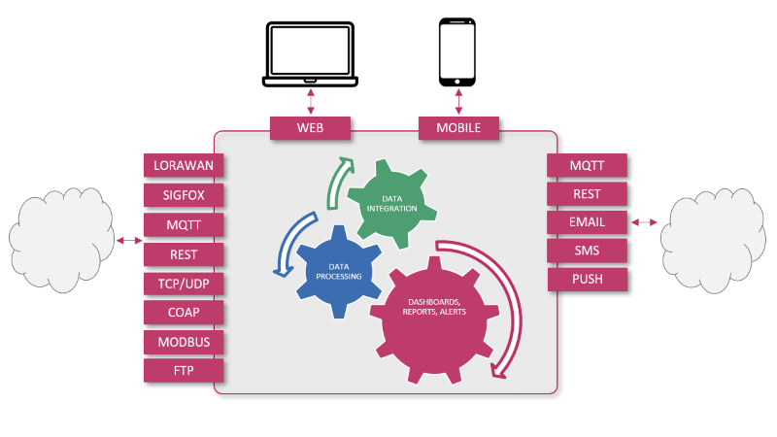
Internet of Things and Device Integration

Slide 4
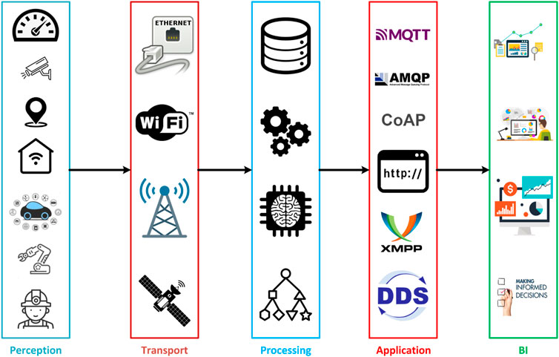
IoT Layered Architecture

Slide 5
What is IoT?
IoT or Internet of Things describes tangible objects with sensors, processing ability, software and other technologies that connect and exchange data with other devices and systems over the internet or other communication networks.
The “thing” in the internet of things is any object that can be assigned an internet protocol (IP) address.
They are able to transfer data over a network, this can include people with heart monitors, farm animals with biochip transponders, or automobiles with built-in sensors.

Slide 6
What is IoT?
IoT devices work by using embedded systems to collect and act on data from their surroundings.
They share sensor data with an IoT gateway, which either sends it to the cloud for analysis or analyses it locally.
The smart devices often communicate with other related devices in an IoT ecosystem and act on the information they receive from each other.
Most of the work done is without human intervention, although people can interact with the devices to set them up, give them instructions, or access the data.

Slide 7
Why is IoT integration important?
The real value of connected devices lies in the IoT data, and to use this data, it’s necessary to gather information from different sources.
Data integration is important for businesses to gain a bird’s eye view of what’s happening in their organization.
Thanks to the network of IoT sensors, they collect valuable data related to different business processes, in different forms and in insanely large volumes.
Having such insight can help enterprises to set feasible goals and design strategies efficiently and with more certainty.

Slide 8
How to get IoT Integration Services?
Management system is used for IoT devices and is the process of collecting streams of data from individual devices, turning them into metrics and from those delivering KPIs for your device ecosystem as a whole.
These systems will typically offer some native integration functionality for IoT devices.
Eventually when customer integrations requests become to complex or result in longer lead times these systems will outsource the automation process.

Slide 9
How to get IoT Integration Services?
They will use data integration tools that enable teams to build IoT integration services quickly with visual drag and drop tools.
These data integration tools such as embedded iPaaS’s enable users to connect to hundreds of other SaaS applications.
This means they can solve the simplest integration use case to the most complicated in a few clicks.

Slide 10
How can integrations help IoT devices?
Integrations are one way people can interact with IoT devices to give them instructions and send relevant data to applications.
Integrations help IoT devices in many ways, one example is sending a simple notification to be distributed to various platforms like email or Slack.
For instance, integrating Salesforce Service Cloud and Slack enabling an IoT to send a notification if there is ever a problem.
To make the integration more complex it can also integrate tickets into a service management platform.
So when a customers clicks on the link sent in the Slack message it will take them to a screen that shows them the issue.

Slide 11
How can integrations help IoT devices?
They can then create a ticket in Salesforce Service Cloud automatically.
Prior to automating the manual task of creating tickets could take up to 10 minutes.
Automating the process reduces the manual mundane task and turns it into a integrated, fast process that takes one click.
Another example would be completely automating the relationship between any problem detected and the ticket creation, ensuring reliability.
Connected devices result in better data integration making data management easier.

Slide 12
Benefits of integrating IoT devices
Transforms the quality of your service
Provides performance analytics
Repeated, manual business processes are automated
Scales and unlocks your growth
Connected devices means better data integration
Increases reliability and data security
Gain a unified view of their data, the data sources and maintain data quality

Slide 13
IoT Integration Possibilities
JSON or via a TCP/IP protocol
MQTT protocol
COAP protocol
Standard LPWAN Network Server (LORA, SIGFOX)
Open APIs

Slide 14

JSON or via a TCP/IP protocol
For IoT sensors communicating over TCP / IP, you can use (JavaScript Object Notation) JSON APIs that can be called through HTTPS queries.
It is also possible to support TCP protocol.

Slide 15

MQTT protocol
The Message Queuing Telemetry Transport (MQTT) protocol is an ISO standard for message communications based on a publish-subscribe model.
It is optimized for remote communications on low bit rate networks.
MQTT is a natural choice for the Internet of Things.
It is often described as the M2M connectivity protocol of the Internet of Things.
The operating principle is based on an architecture where a “Client” (a sensor for example) publishes (Publish) its data, by defining a “Topic”, with a Broker. Other Clients may subscribe (Subscribe) to receive data published on a particular “Topic”.

Slide 16

COAP protocol
COAP (Constrained Application Protocol) is a protocol optimized for the Internet of Things.
It was developed to allow the transmission of data from devices with limited capacities, having to communicate on low-speed networks.
It allows the communication of data encoded in binary form, in UDP.
Compared to MQTT, this protocol is lighter because it transmits fewer bytes (MQTT often transmits data in JSON or XML format, bcp more verbose) and UDP packets are less “expensive” than TCP used by MQTT.

Slide 17


Standard LPWAN Network Server (LORA, SIGFOX)
LORAWAN Network Servers Integration
Standardized integrations with Network Servers such as LORAWAN network or for the SIGFOX network.
LoRaWAN is a low-power, wide area networking protocol built on top of the LoRa radio modulation technique to wirelessly connects devices to the internet and manages communication between end-node devices and network gateways.
SigFox - Alternative to LORAWAN Technology
SigFox is an international operator, present in many countries, which is a LPWAN (Low Power Wide Area Network) alternative to LORAWAN.

Slide 18

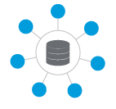
Open APIs
Developing third-party web or mobile applications
You can develop dedicated web or mobile applications based on APIs
Integration with back-end software (ERP, BMS, WMS ...)
Whether an ERP (Enterprise Resource Planning), a BMS (Building Management System), a CRM, WareHouse Management Software (WMS).
APIs can be used to integrate information on machines, facilities, premises in which sensors are installed.
The principle is that the “master” data remains managed by the remote system, which communicates the necessary updates.
Transmit the data collected, the analysis carried out, the alerts to be processed …

Slide 19
IoT Integration Challenges
Internet of things (IoT) integration enables data transmission from connected devices to software or other devices.
This helps to implement data analytics to gain insights, enable real-time monitoring, and automate different processes.
Yet, a Gartner Research survey shows that companies list IoT integration challenges as one of the key areas of concern when implementing IoT solutions.

Slide 20
What are the challenges facing IoT?
A large number of IoT devices
IoT projects include a wide range of devices, massive amounts of data, and a large number of application programming interfaces (APIs) – all of which can create some IoT challenges at the implementation phase.
Incompatibility of connected devices
IoT technologies from different vendors may present both security and incompatibility concerns.
Stream messaging
Gathering and analyzing a stream of data from a wide variety of smart sensors is an important step in IoT projects.
A rising number of endpoints
Traditional integration platforms are built to support a limited number of endpoints.
New communication protocols
Some IoT smart sensors utilize new communication protocols.

Slide 21
How to overcome IoT integration challenges
Have a well-defined IoT integration strategy
Realize the project scope, opportunities, challenges, possible solutions, and implications.
Check communication requirements
Understand how devices will interact in your project
Use API for IoT integration
The use of APIs is one of the most effective yet simplest ways to ensure data integration, device communication, and network.
Opt for an API-first strategy
API-first approach and API-centric strategy since most IoT projects are cloud-based.

